Slide 1



LOCKOUT / TAGOUT (LOTO)
SAFETY TRAINING
©2014 PROFESSIONAL RESOURCES IN SYSTEM MANAGEMENT, LLC | PROPRIETARY & CONFIDENTIAL

Slide 2
Training
  To be completed by new employees and on a annual basis.
  Training is 2 parts:
    Lockout / Tagout Safety Training Video : https://www.youtube.com/watch?v=is77KiZ16_o
      Why we have Lockout / Tagout procedures
      Types of energy that needs to be locked out prior to servicing or work
      Hazards associated with not using LOTO
    On the job training from a supervisor or manager
      Complete as necessary
Additional Training Video as Needed:
http://vimeo.com/90989629

Slide 3
PURPOSE
WHEN USED PROPERLY, THE LOCKOUT / TAGOUT PROGRAM CAN SAVE LIVES.THE LOCKOUT / TAGOUT PROGRAM IS USED TO INFORM PERSONNEL OF IMMEDIATE, EXISTING, OR POTENTIAL HAZARDS WHICH MAY PRODUCE OCCUPATIONAL INJURY OR ILLNESS. THE LOCKOUT / TAGOUT PROGRAM ALSO ESTABLISHES REQUIREMENTS TO PREVENT UNEXPECTED START-UP OF MACHINES OR EQUIPMENT THROUGH THE LOCKOUT OR TAGOUT OF ENERGY ISOLATION DEVICES

Slide 4
SIGNS AND TAGS
SIGNS AND TAGS ARE USED TO PROVIDE INFORMATION. WHEN USED PROPERLY, THEY WARN OF DANGER, CAUTION
PERSONNEL, OR PROVIDE INFORMATION. SIGNS AND TAGS ARENOT INTENDED AS SUBSTITUTES FOR PREFERRED ABATEMENT METHODS SUCH AS ENGINEERING CONTROLS, LOCKOUT PROCEDURES, SUBSTITUTION, ISOLATION, OR SAFE WORK PRACTICES. THEY ARE USED AS ADDITIONAL SAFETY GUIDANCE AND TO INCREASE THE EMPLOYEE’S AWARENESS OF POTENTIAL HAZARDS.

Slide 5
PROCEDURES FOR LOCKOUT / TAGOUT
  Before a supervisor or operator turns off a machine or equipment, they shall have knowledge of the type and magnitude of the energy source, the hazards of the energy source to be controlled, and the method or means to control the energy source.
  The machine or equipment shall be turned off or shut down using the normal stopping and shutdown procedures.
  - Depress the stop button, open the toggle switch, close the shut off valve, etc…
The initial lockout or tag-out devices shall be attached to each energy isolating device by the authorized personnel
Lockout or tag-out devices, where used, shall be attached in a manner that will hold the energy isolating devices in a “SAFE” or “OFF” position.

Slide 6
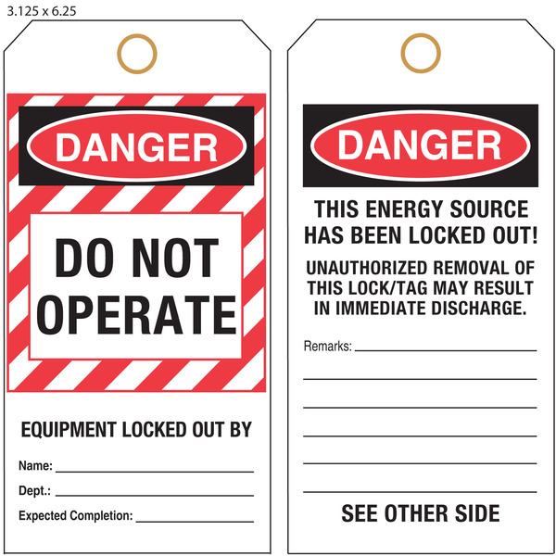
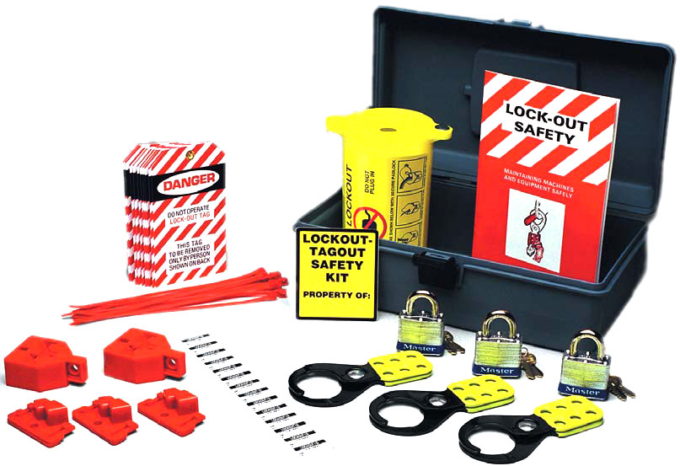
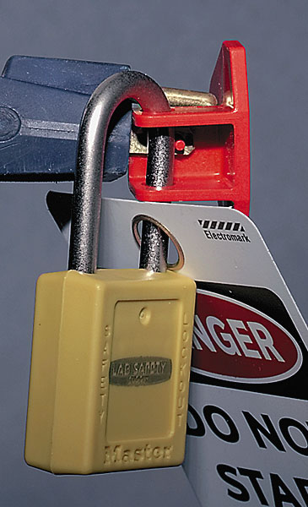
PROCEDURES FOR LOCKOUT / TAGOUT
Tag-out devices with proper tags, with energy isolating devices designed with the capability of being locked shall be attached at the same point as the lock. In cases where energy isolating devices cannot be locked because of design, tag-out devices shall be attached. The tag will be secured with a self-locking and non-releasable attachment that has a minimum unlocking strength of no less than 50 lbs (Nylon or plastic cable tie-off strap). These devices should be attached in such a manner as to interfere with the operation of energy isolating devices.

Slide 7
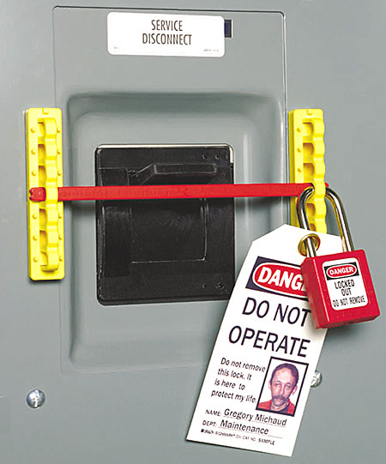
PROCEDURES FOR LOCKOUT / TAGOUT
Where a tag cannot be attached directly to the energy isolating device, the tag shall be located as close as safely to the device in a position that will be immediately obvious to anyone attempting to operate the device.
NOTE: Whenever major replacement, repair, renovation, or modification of machines or equipment is performed, and whenever new machines or equipment are installed, energy isolating devices for such machines or equipment shall be designed to accept a lockout device.

Slide 8
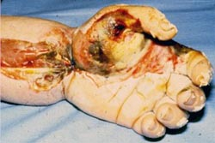
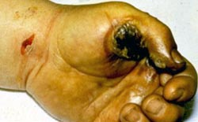
PROCEDURES FOR LOCKOUT / TAGOUT
Prior to starting work on machinery or equipment that has been locked out or tagged out, the shift supervisor shall verify that the machine or equipment has been de-energized or isolated. Failure to de-energize or isolate electrical power to the machine or equipment could result in burn, loss of body parts, or death.

Slide 9
PROCEDURES FOR LOCKOUT / TAGOUT
Before restoring machines and equipment to service the supervisor or employee will:
-Ensure all personnel, tools, and maintenance or servicing equipment have been removed and guards have been reinstalled
-Notify personnel the locks or tags have been removed and equipment is in service
-Remove all locks or tags and restore the energy isolating device to the “ ON “ position.
Some of the tags that might be seen or used:
-Danger Tag
-Caution Tag
-Out of Order Tag
-Do Not Start Tag

Slide 10
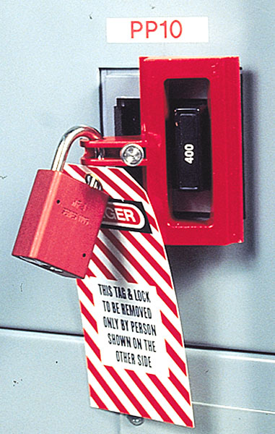
LOCKOUT/TAGOUT OF MC2000 TEST STAND
The Main Circuit Breaker Panel should look like the picture to the left.
The mechanism used to lock out the circuit breaker is on the right.
DON’T FORGET TO PUT A LOCKOUT TAG ON THIS BREAKER AS WELL

Slide 11
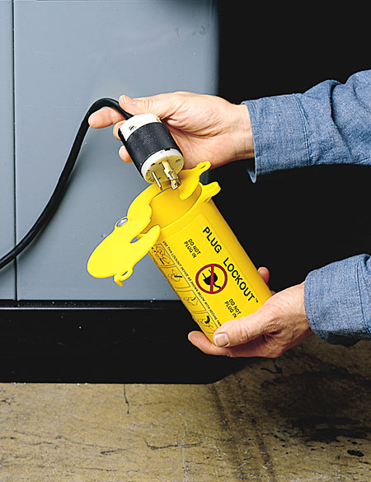
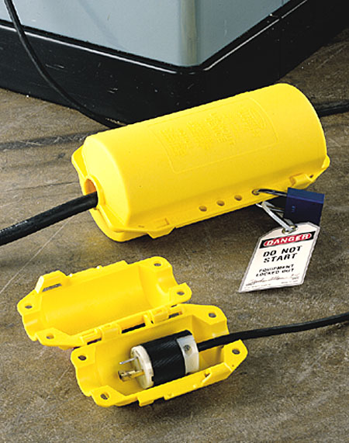
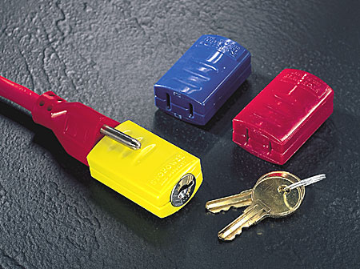
COMMON ELECTRICAL CONNECTOR PLUG
To use the lockout device to the left, simply slide the plug into the hole. Close the lever on top and install a key lock. Tag the device as being locked out. Annotate the AFTO Form 244 stating that the piece of equipment is locked out and why. If the equipment is part of a CTK, then document the ACC Form 146, stating that the equipment is locked out.
To use the lockout device on the right, simply lay the plug into the open gap. Close the lid, lock, and tag the device. Follow the same guidelines stated above for documentation of the equipment.
To use the device to left, slide the lock over the 2 main prongs, turn the key to lock. Documentation of the equipment is the same as stated above.

Slide 12
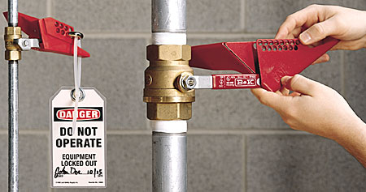

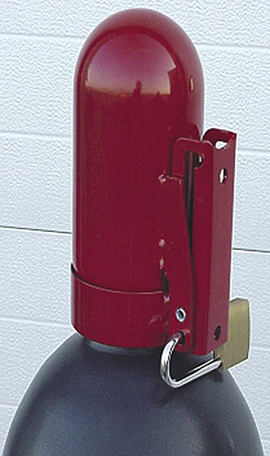
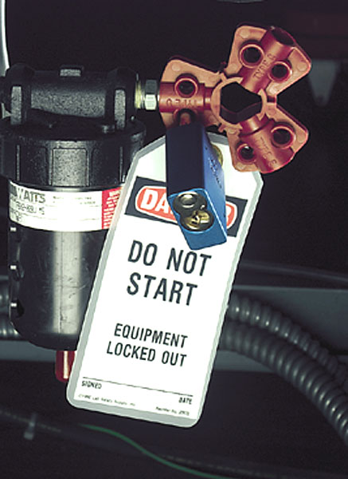
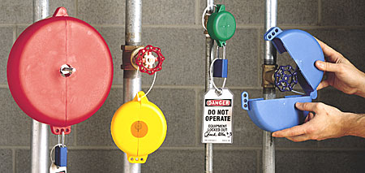
VALVE LOCKOUT DEVICES
These are some of the devices used to lockout valves. Most of them you just clamp on, lock, and tag.

Slide 13
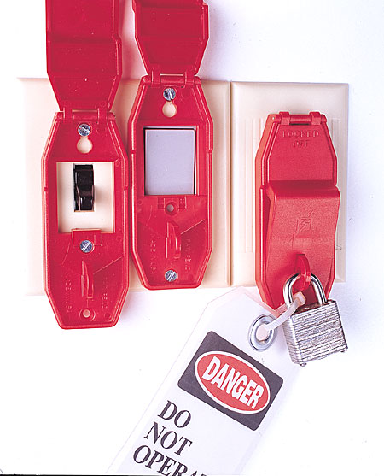
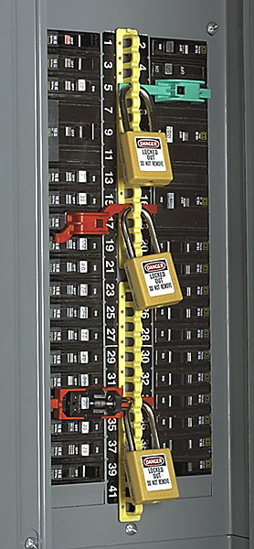
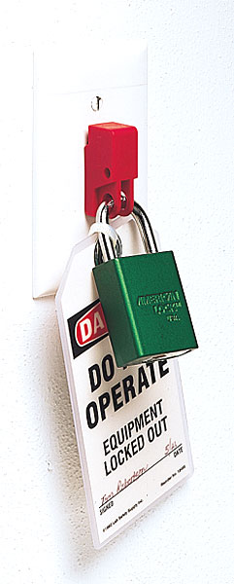
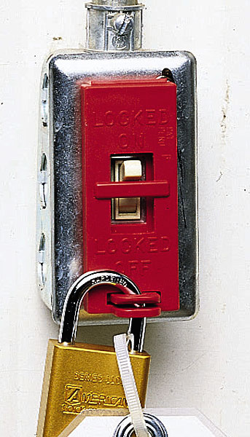
OTHER ELECTRICAL LOCKOUTS

Slide 14
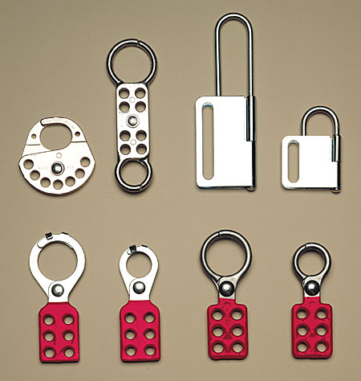
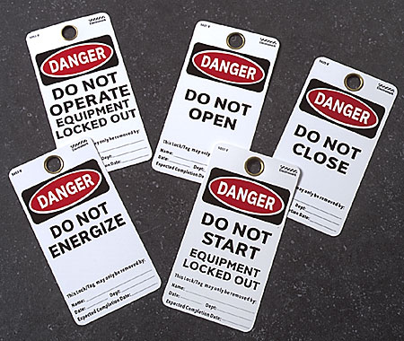
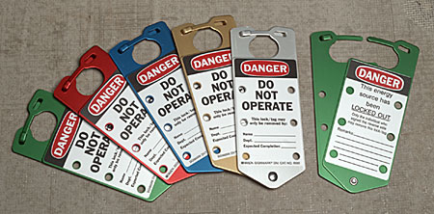
SOME TAG LOCKS AND TAGS

Slide 15
ONLY DESIGNATED PERSONNEL ARE ALLOWED TO REMOVE ANY LOCKOUT / TAGOUT DEVICE!

Slide 16
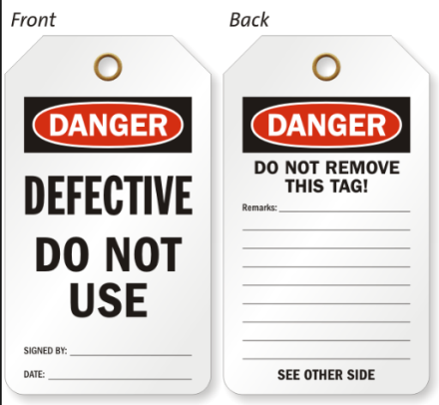
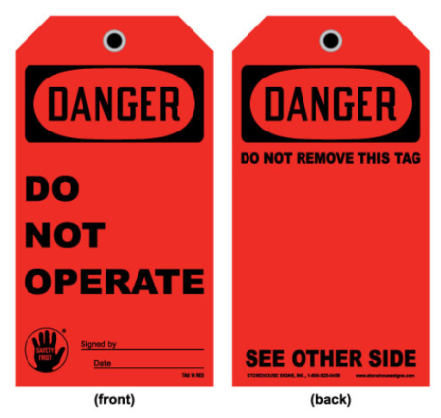
Tagging Procedures
All tools that are unsafe to use must be Tagged “Do Not Use.”
    Examples of Tools that should be tagged are:
                Power Tools without guards.
                Power Tools with damaged cords or hoses.
                Hand Tools which are broken or damaged.
                Power Tools with broken safety switches.
  Tags to be used should look similar to the following and should be provided by the safety Manager.

Slide 17
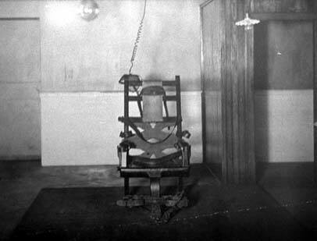
IF YOU DON’T WANT TO USE THE LOCKOUT / TAGOUT PROGRAM, THEN YOU MIGHT AS WELL HAVE A SEAT

Slide 18

Certificate of Completion
Lockout / Tagout (LOTO)
Safety Training
Computer Based and Instructor Lead
Date:
is awarded to:
Name of Instructor

Slide 19
THANK YOU
UNEQUALLED EXPERIENCE, INVALUABLE RESULTS.
©2014 PROFESSIONAL RESOURCES IN SYSTEM MANAGEMENT, LLC | PROPRIETARY & CONFIDENTIAL

