Slide 1



Hazard Communication
Training
©2020 PROFESSIONAL RESOURCES IN SYSTEM MANAGEMENT, LLC | PROPRIETARY & CONFIDENTIAL

Slide 2
Hazard Communication
Hazard Communication Standard
21 minute training video: https://youtu.be/6zEmw92yHbo
Employers must provide
you with
  A written hazard
  communication program
  A list of hazardous
  chemicals
  SDSs (MSDS)
  Labels on containers
  Training
  Employee Responsibilities
  Read and interpret labels and SDSs (MSDS)
  Follow employer instructions and warnings
  Identify hazards before starting a job
  Participate in training
Notes:
A Hazards Communications program will be established at the Unit Level.
Training will be conducted yearly at a minimum.
Additional PowerPoint slides can be obtained through the additional support package.

Slide 3
Hazcom
Major changes to the Hazard Communication Standard
  Hazard classification: Provides specific criteria for classification of health and physical hazards, as well as classification of mixtures.
  Labels: Chemical manufacturers and importers will be required to provide a label that includes a harmonized signal word, pictogram, and hazard statement for each hazard class and category. Precautionary statements must also be provided.
  Safety Data Sheets: Will now have a specified 16-section format.
  Information and training: Employers are required to train workers by December 1, 2013 on the new labels elements and safety data sheets format to facilitate recognition and understanding.
Notes:
The Hazard Communication Standard (HCS) is now aligned with the Globally Harmonized System of Classification and Labeling of Chemicals (GHS). This update to the Hazard Communication Standard (HCS) will provide a common and coherent approach to classifying chemicals and communicating hazard information on labels and safety data sheets.
Once implemented, the revised standard will improve the quality and consistency of hazard information in the workplace, making it safer for workers by providing easily understandable information on appropriate handling and safe use of hazardous chemicals
GHS does not replace OSHA regulation, it simply is intended to standardize the information about hazard substances for people all over
the world.
4. Additional PowerPoint slides can be obtained through the additional support package.

Slide 4
Phase-in Period for GHS into Hazard Communication Standard
Effective Completion Date | Requirement(s) | Who
December 1, 2013 | Train employees on the new label elements and SDS format. | Employers
June 1, 2015 December 1, 2015 | Comply with all modified provisions of this final rule, except: Distributors may ship products labeled by manufacturers under the old system until December 1, 2015. | Chemical manufacturers, importers, distributors and employers
June 1, 2016 | Update alternative workplace labeling and hazard communication program as necessary, and provide additional employee training for newly identified physical or health hazards. | Employers
Transition Period | Comply with either 29 CFR 1910.1200 (this final standard), or the current standard, or both. | All chemical manufacturers, importers, distributors and employers
Notes:
Globally Harmonized System, like everything introduced new into the industry has a phase-in period. The chart above depicts the drop dead dates for training employees, compliance with all modified provisions of the final rule, as well as integration into their organizations Hazard Communication Program.

Slide 5
SDS Format: 16 headings
1. Identification
2. Hazard(s) identification
3. Composition/information on ingredients
4. First-aid measures
5. Fire-fighting measures
6. Accidental release measures
7. Handling and storage
8. Exposure control/personal protection
9. Physical and chemical properties
10. Stability and reactivity
11. Toxicological information
12. Ecological information*
13. Disposal considerations*
14. Transport information*
15. Regulatory information
16. Other information
*SDS—Formerly known as Material Safety Data Sheets (MSDS)
Notes:
Most manufacturers put more information on the MSDS for liability issues. There is no set format to the MSDS and they can range in length from 1 page to 20 or more pages.
The SDS will contain 16 headings. All SDS will be in this standard format which will make it easier for both employers and employees to find the information that they need for their workplace. The GHS SDS headings, sequence and content are similar to the ISO, EU and ANSI MSDS/SDS requirements, except that the order of sections 2 and 3 have been reversed. The SDS should provide a clear description of the data used to identify the hazards.

Slide 6
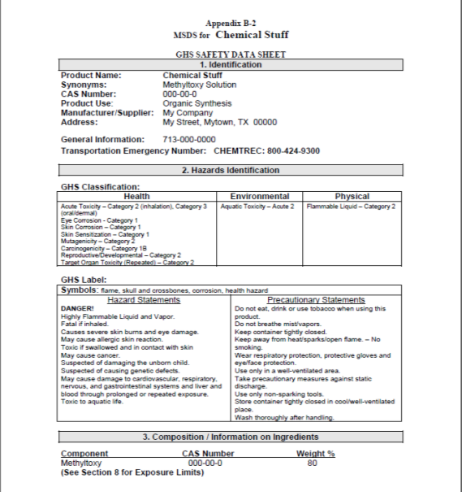
SDS Format Example
Notes:
First page of a sample SDS—note the specific sections. All SDS will have the sections/headings in this order/format. This will make finding specific information easier. See appendix document “A Guide to The Globally Harmonized System of Classification and Labeling of Chemicals (GHS)” section B-2 for full SDS example.

Slide 7









Pictograms
Environment (Non-Mandatory)
Corrosion
Flame over Circle
Gas Cylinder
Skull and Crossbones
Skin Corrosion/ burns
Eye Damage
Corrosive to Metals
Oxidizers
Gases under Pressure
Acute Toxicity (fatal or toxic)
Aquatic Toxicity
Exclamation Mark
Flame
Health Hazard
Exploding Bomb
Flammables
Pyrophorics
Self-Heating
Emits Flammable Gas
Self-Reactives
Organic Peroxides
Carcinogen
Mutagenicity
Reproductive Toxicity
Respiratory Sensitizer
Target Organ Toxicity
Aspiration Toxicity
Explosives
Self-Reactives
Organic Peroxides
Irritant (skin and eye)
Skin Sensitizer
Acute Toxicity (harmful)
Narcotic Effects
Respiratory Tract Irritant
Hazardous to Ozone Layer (Non-Mandatory)
Pictograms are required in the revised Hazard Communication Standard. The nine pictograms above are standardized.
Notes:
There are nine standardized pictograms from GHS that OSHA has included in their revised Hazard Communication Standard. These pictograms are required on hazard communication labeling.
We are responsible for training our personnel on the meanings and associated hazards of the pictograms not for determining which pictogram is to be used on which chemical. The chemical manufacturer, importer or distributor is responsible for determining which pictogram applies to the chemical(s).
Note: If Units want to print this slide presentation please use a color printer as the pictograms are required to have red borders. The red borders increase comprehensibility.
Note 2: Blank red diamonds are not permitted on a label.

Slide 8

Certificate of Completion
Hazard Communication / GHS Hazcom
City, State
Date: mm/dd/yyyy
is awarded to
Name

Slide 9
THANK YOU
UNEQUALLED EXPERIENCE, INVALUABLE RESULTS.
©2020 PROFESSIONAL RESOURCES IN SYSTEM MANAGEMENT, LLC | PROPRIETARY & CONFIDENTIAL

